Slide 1

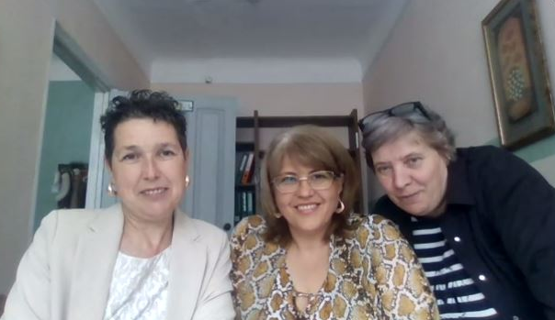

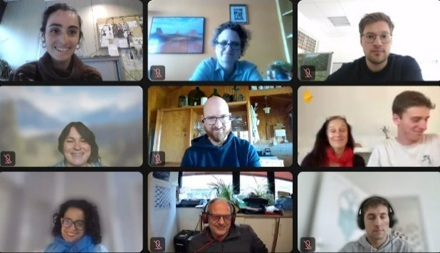
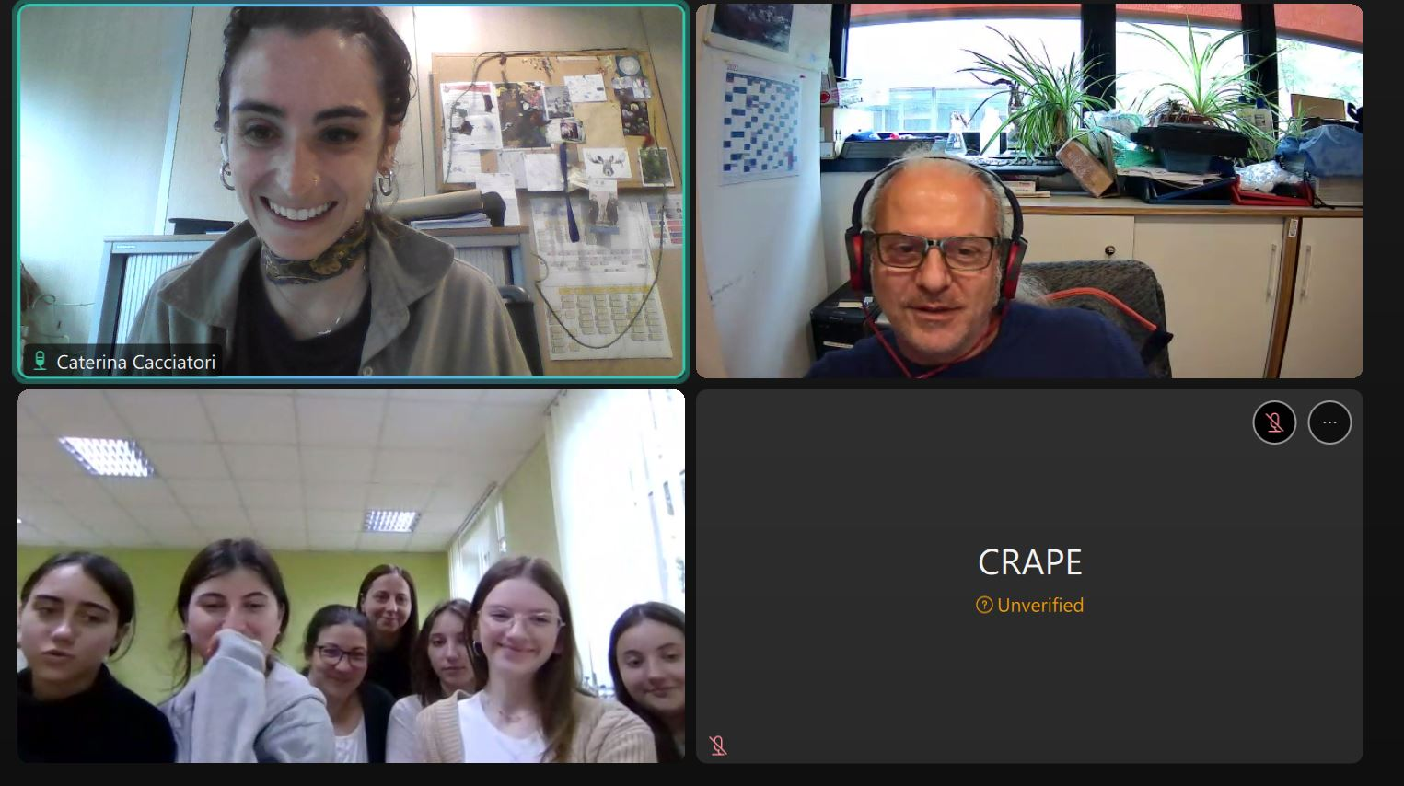
Citizens and pesticides:
A water quality
story.
Caterina Cacciatori, Giulio Mariani, Sara Comero, Bernd Manfred Gawlik
Joint Research Centre (JRC) of the European Commission
Notes:
Cover slide option 1. Check layout for option 2 without the banner and footer

Slide 2

Flow
01.
About the JRC
02.
The Gems of Water
03.
How does it work?
04.
Testing..
05.
Outcome
06.
Expectations vs. Reality
07.
Lessons learnt & Tips
08.
Our latest project: JDS5

Slide 3
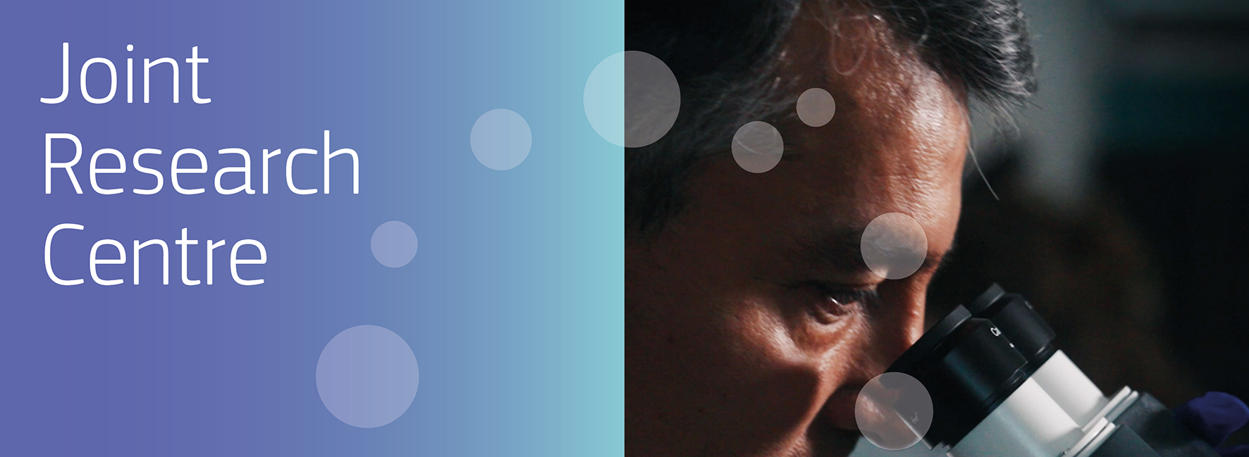
About the JRC
Notes:
JRC corporate video – general explanation about JRC for all audiences
https://www.youtube.com/embed/uF7uruvjAgg

Slide 4

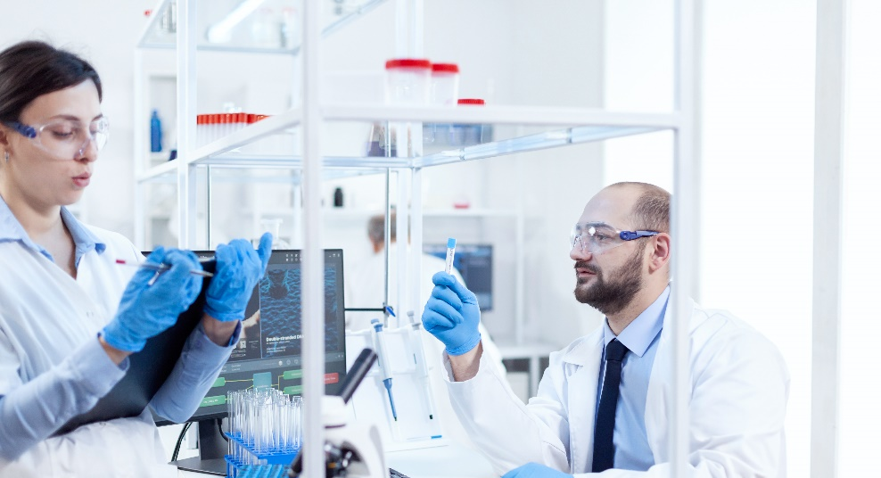
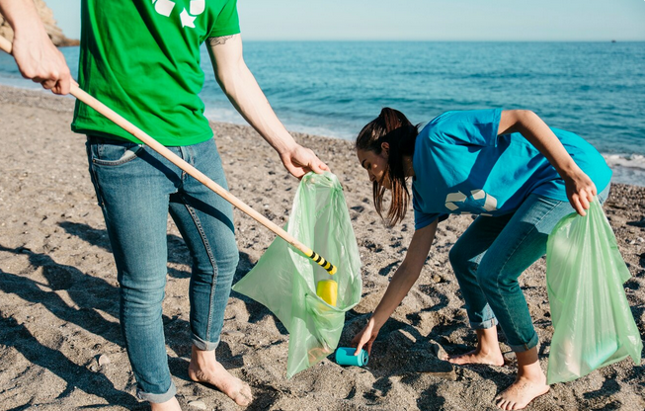

Citizen science
WHAT SCIENTISTS THINK IT IS
WHAT CITIZENSTHINK IT IS
WHAT POLICY MAKERS THINK IT IS
WHAT IT
ACTUALLY IS?

Slide 5

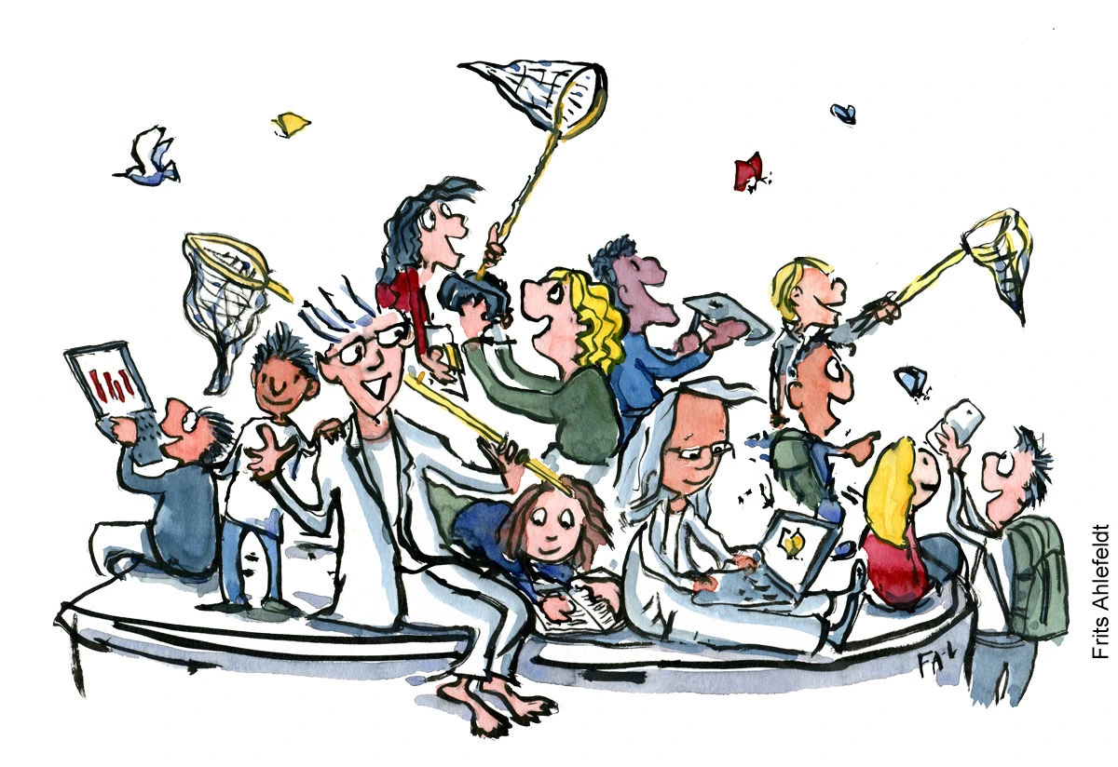
The Gems of Water
+
advanced wide-target screening technology
engagement of citizens
to monitor up to 400 pesticides in water
Other projects:
The Pesticide Detectives (RMIT AQUEST)
Pesticide Watch (Deakin University)

Slide 6

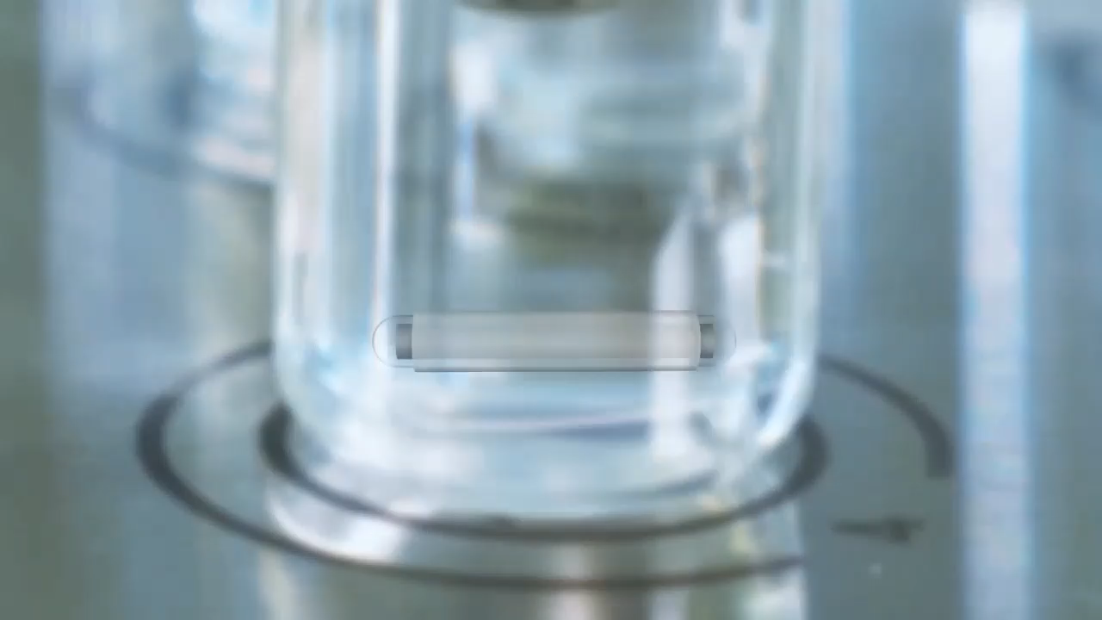
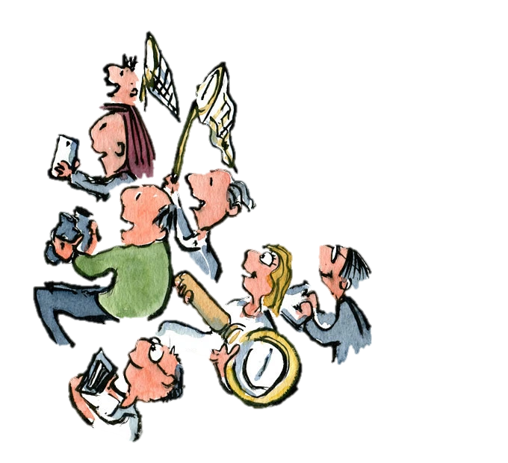
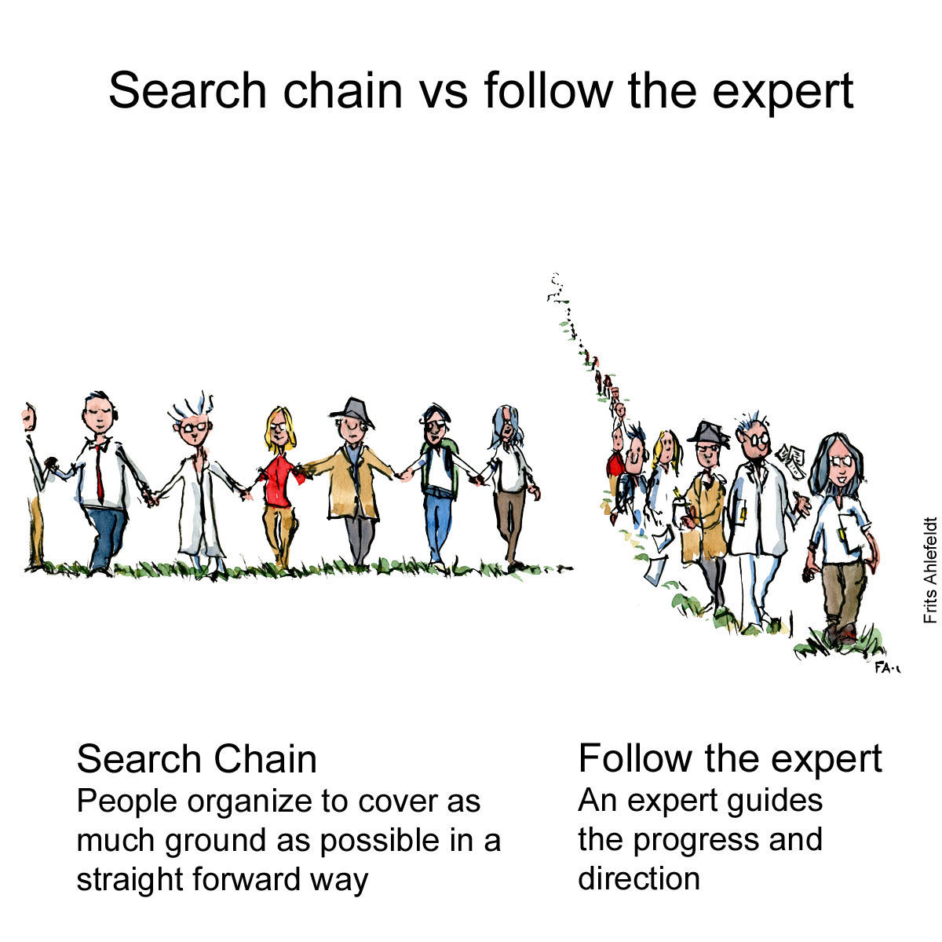
Stir bar sorptive extraction
Magnet
Glass
PDMS Coating
Does this work with citizen engagement?
Easy and “ecological” extraction through magnetic stirring
Small sample volume
Stability of samples
Easier logistics

Slide 7
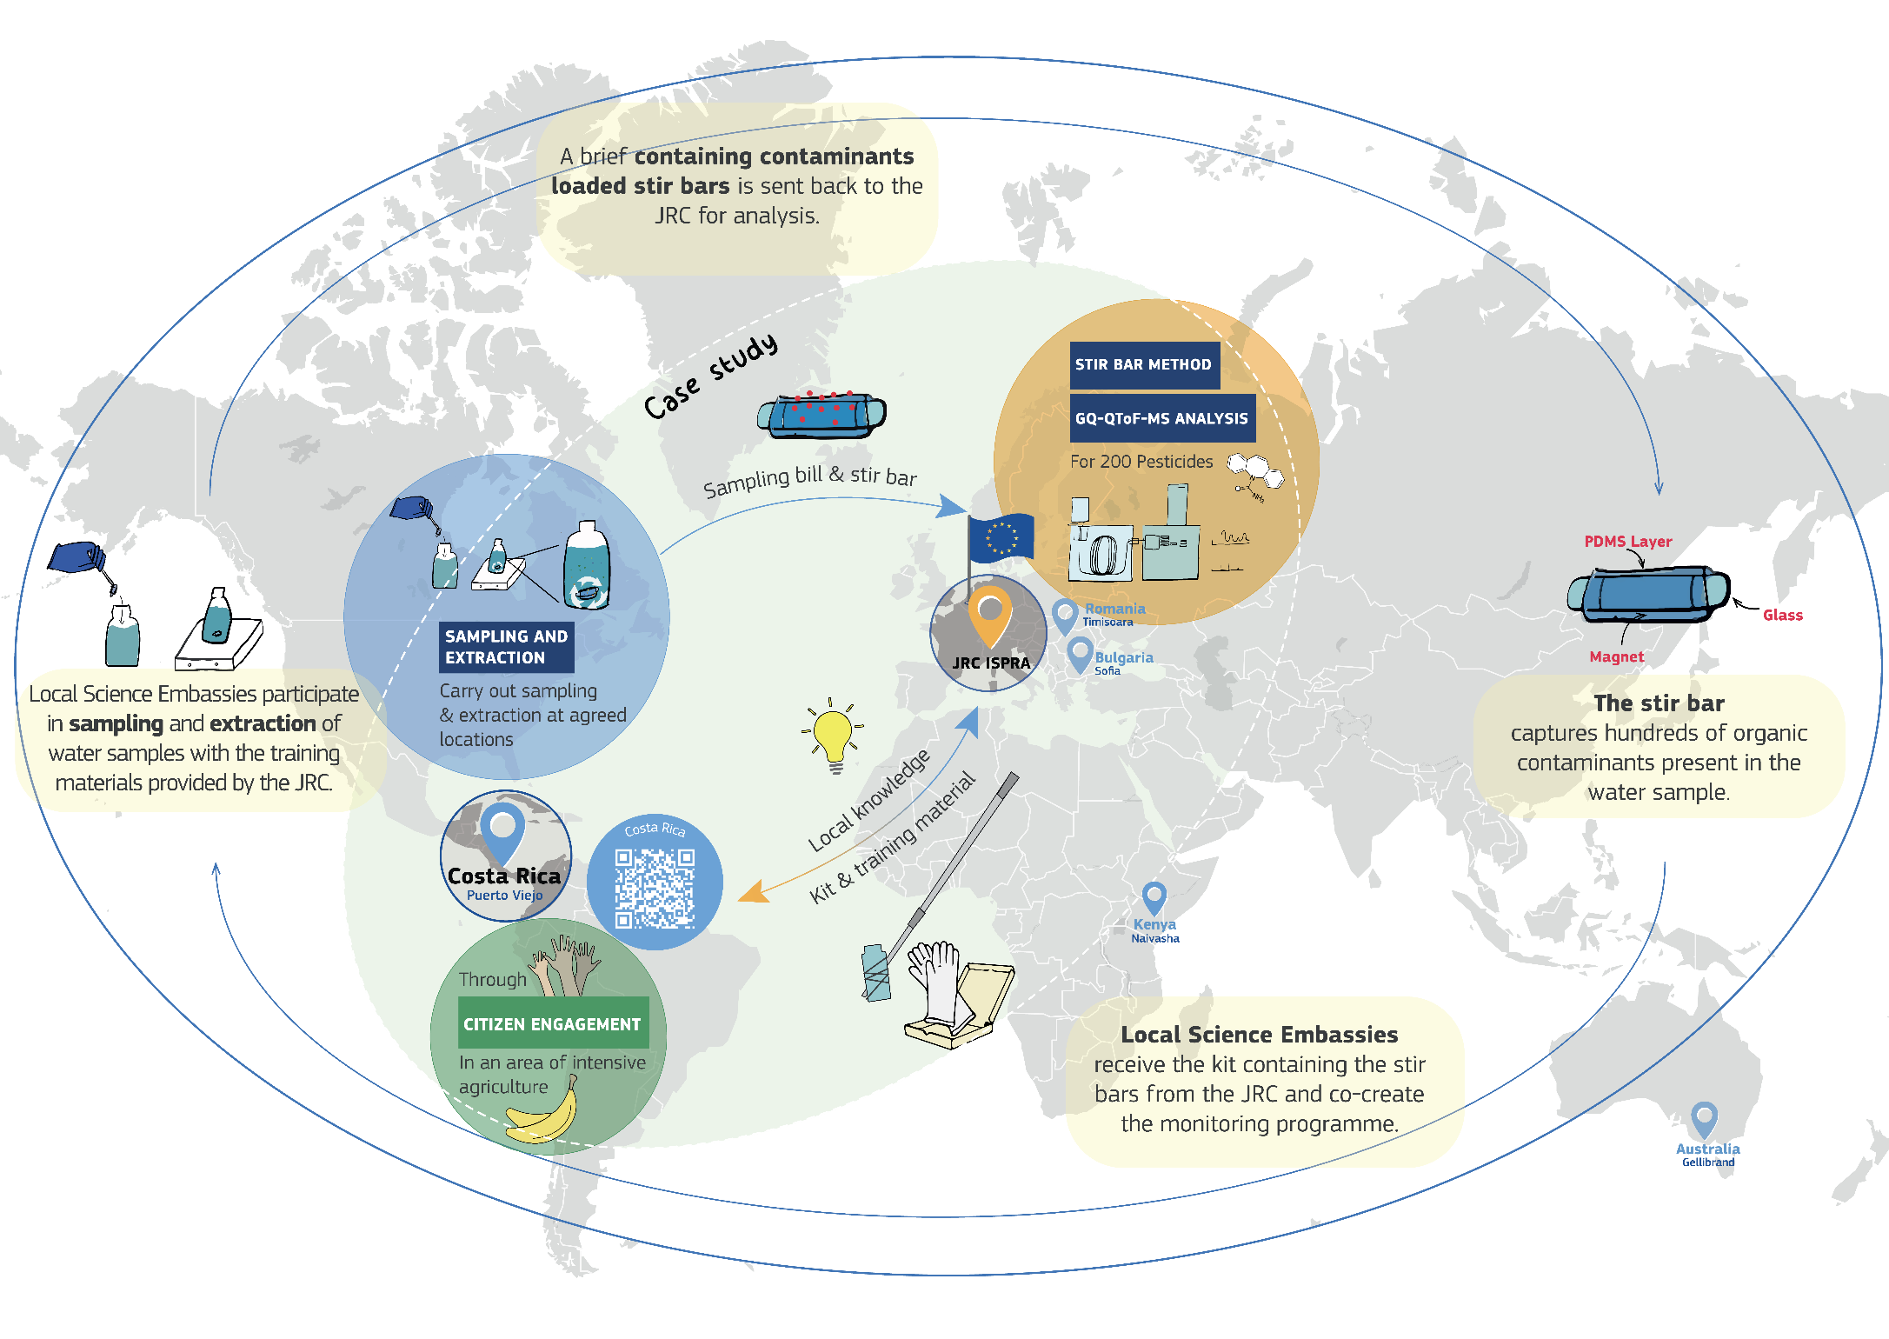
Notes:
Map of The Gems of Water workflow

Slide 8
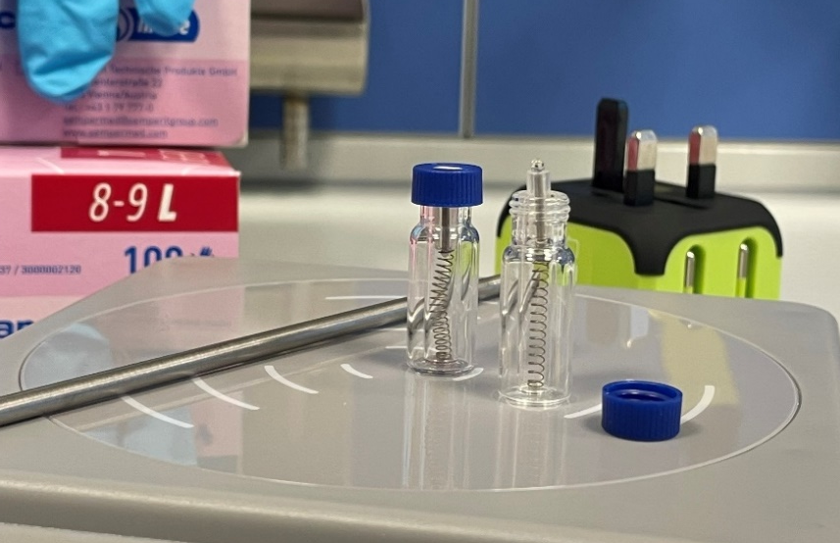
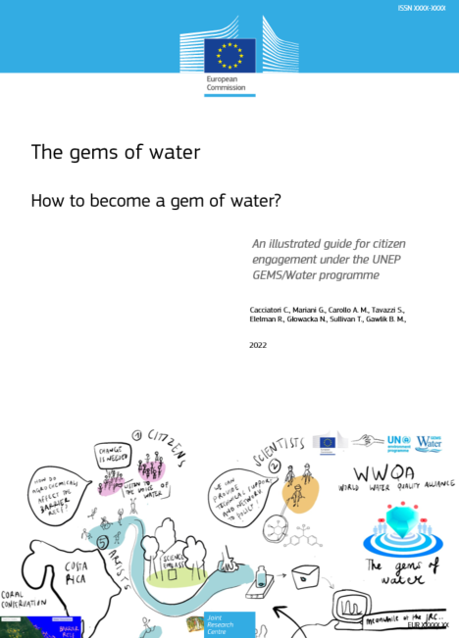

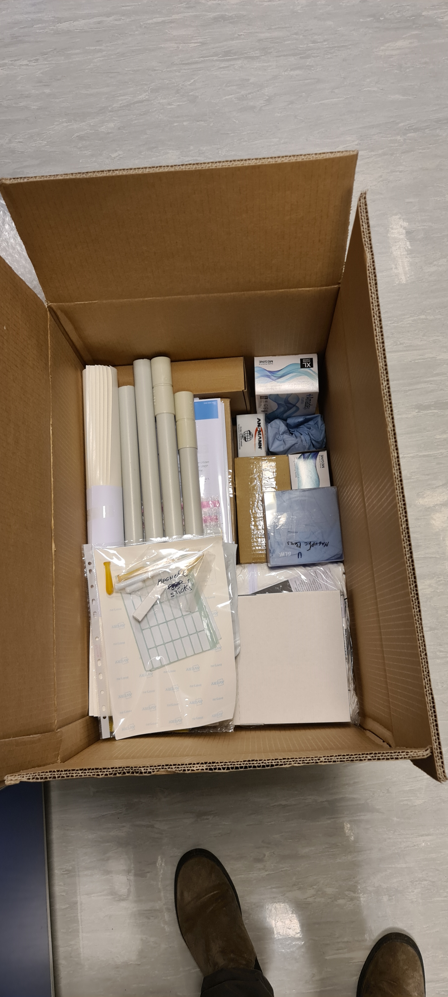
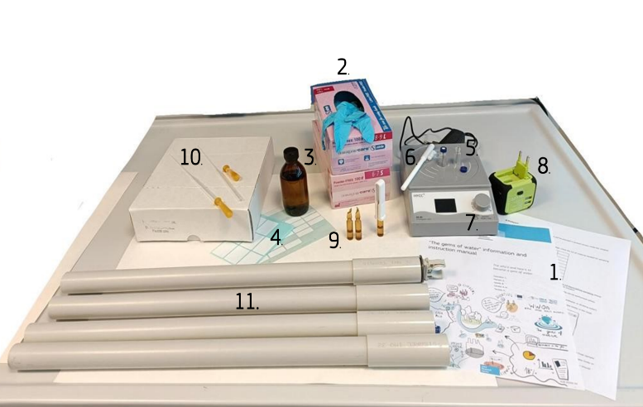
The kit

Slide 9
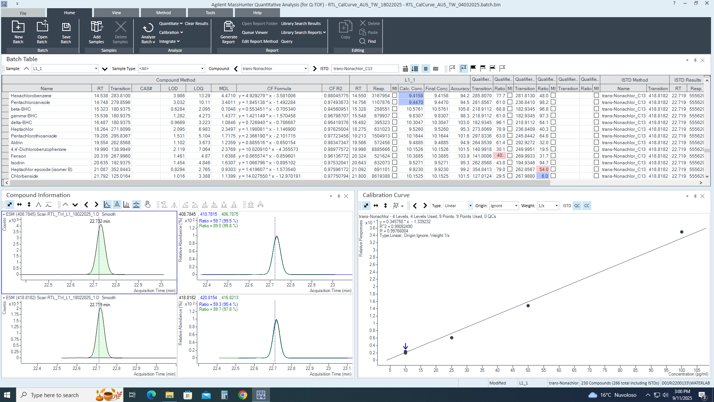
Sample analysis
Sample Analysis for 400 pesticides with Gas Chromatography Quadruple Time of Flight Mass Spectrometry
QA/QC:
Blanks
Internal standard addition before extraction by the citizen scientists.
Chromatogram and calibration curve for trans-Nonachlor 13C10

Slide 10
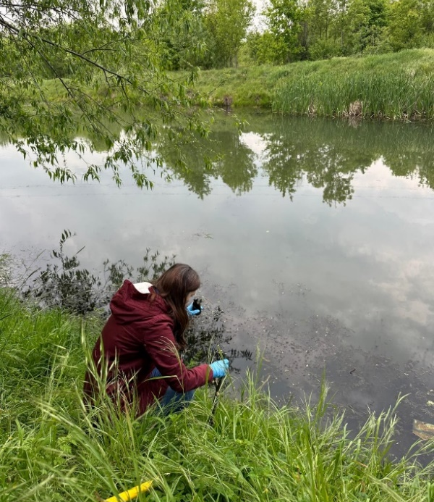
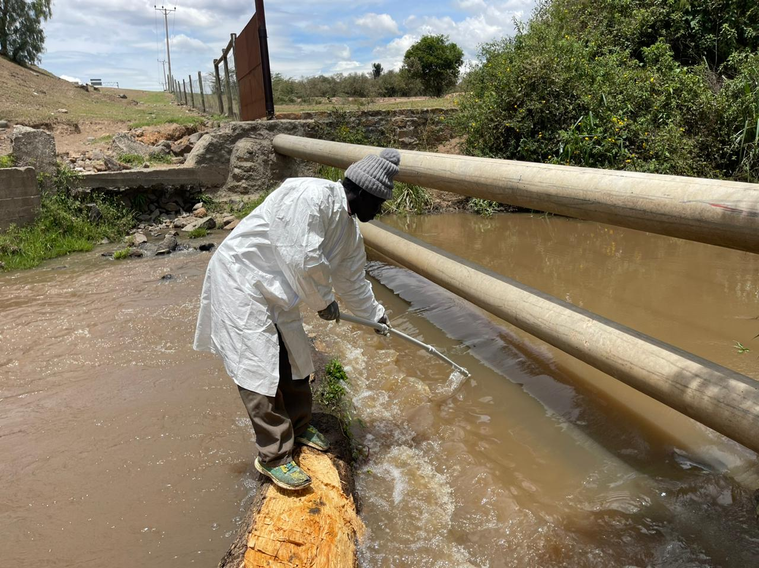
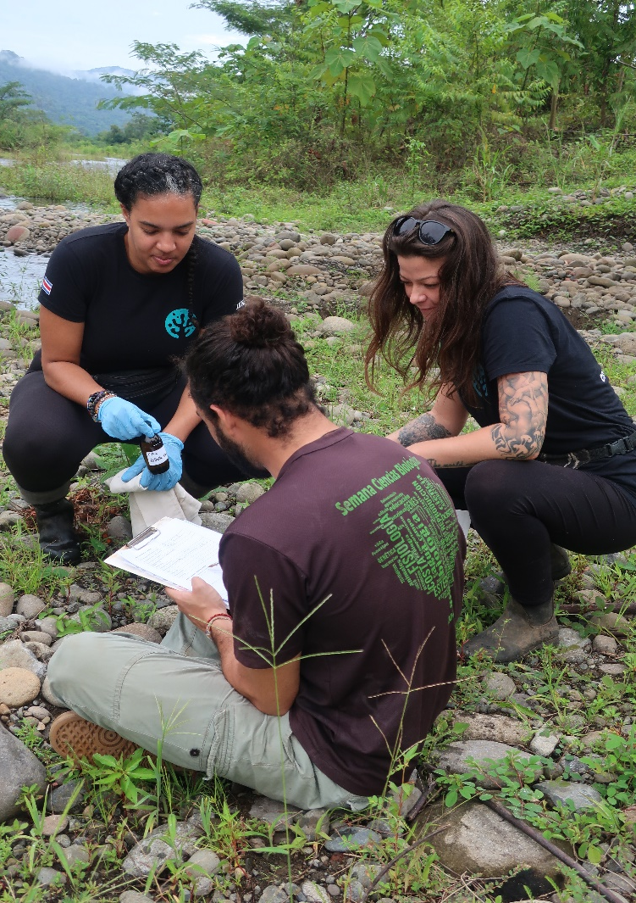
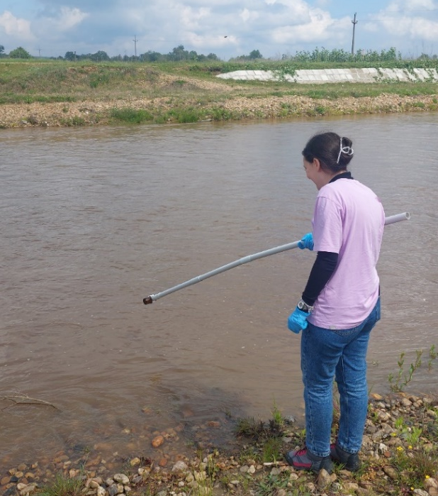
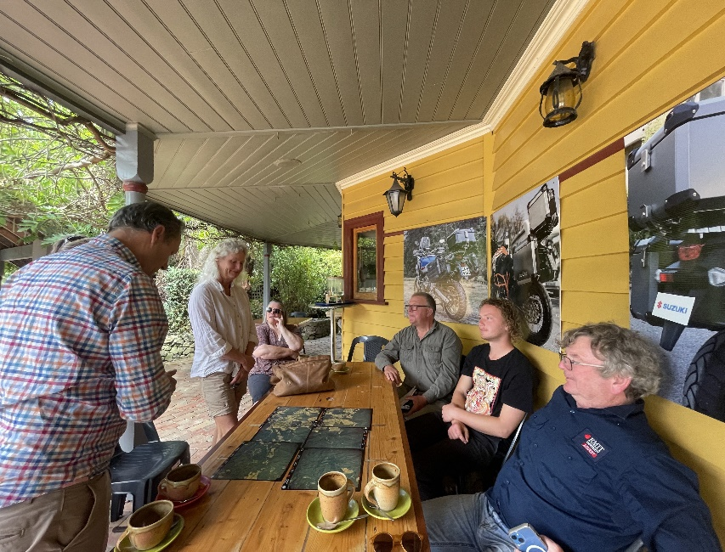
Trying it out..
Sofia University, Young Water Professionals Bulgaria in May 2024
Kenya
Costa Rica
Bulgaria
Together with Kenya Water Resource Users Association, in October 2023.
Romania
Together with Land and Water Resources Otways Catchment over 2024
Polytechnic University of Timisoara, Aslan National College, Aquatim,
in April 2024
Together with Coral Conservation, in February-March 2023.
Australia

Slide 11

Results
Major group of pesticides detected:
fungicides
(except in Romania → herbicide)
Pesticides found in high frequency and concentrations:
fungicides fluopyram, boscalid, tebuconazole, difenoconazole, biphenyl;
herbicide simazine
wood preservatives 2,4,6-trichlorophenol
Mostly linked to surrounding land-use
Notes:
Cumulative results, like how many pesticides were found – which are the most common among cases → is it fungicides for instance? – actually 41.7% insecticide, 24.3% fungicide, 20.0% herbicide.

Slide 12



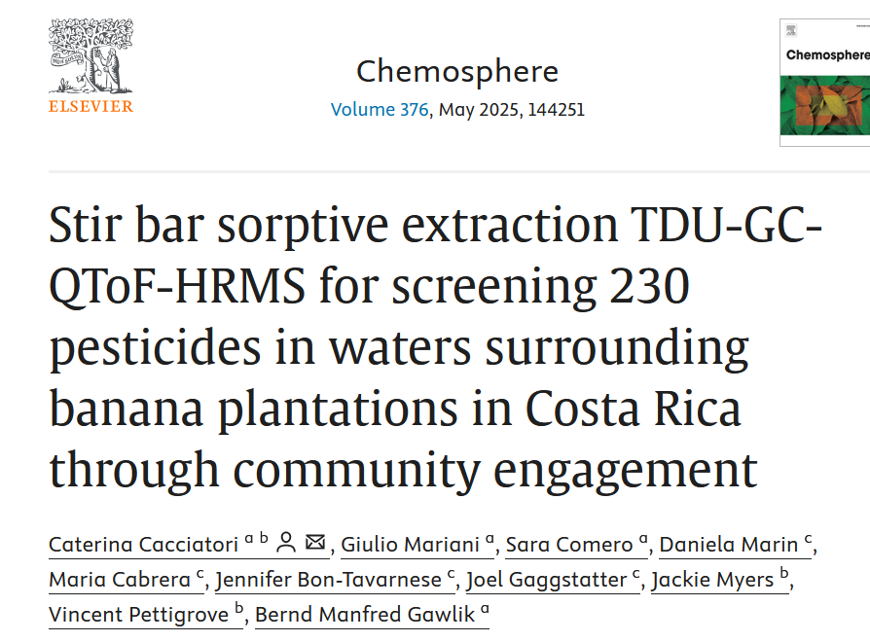
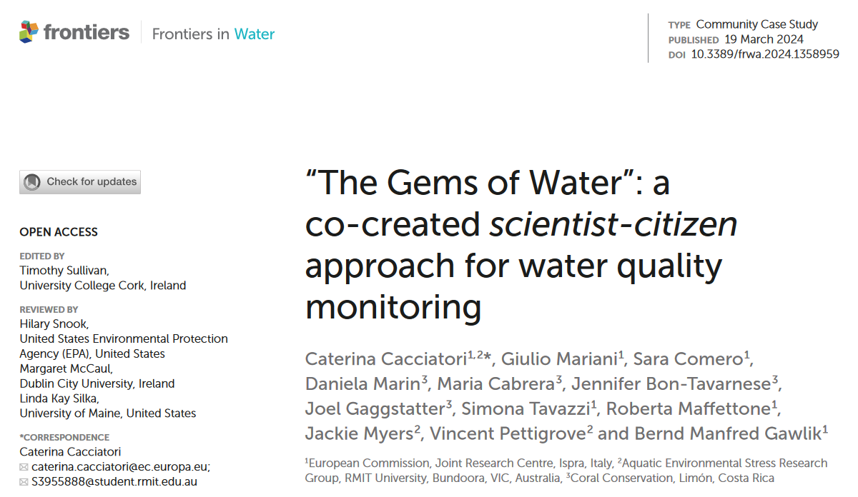
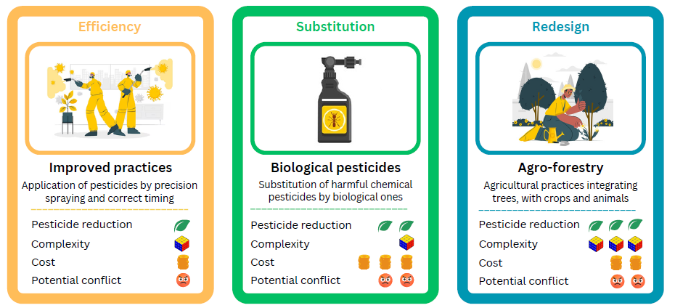

Outcomes
Role play
Scientific papers
Idea: Water quality data → educational material
Role-play game on debating solutions to water contamination
On Costa Rica:
On Kenya: under review.
Platform
Easily and accessible online platform where publicly shared
Notes:
Add QR with link to ro --play → bring cards and material so people can see it.
I think it’s important to say that we also provide a Eco toxicological risk assessment – through that we can identify the few pesticides that drive toxicity → substitute them?!

Slide 13
Expectations vs. Reality
For scientists
For citizens
Expectations:
doing science and data analysis;
everything is clear and easy in the protocols
Reality:
logistics-coordination-communication;
very rewarding;
forgetting something important
Expectations:
data will be useful, used and insightful
Reality:
obstacles in publishing, channeling, using the data
Expectations:
finding interesting results to answer question/doubts/concerns; contribute to environmental care
Reality:
no-effect data;
data analysis takes time;
sampling and extraction require organization;

Slide 14
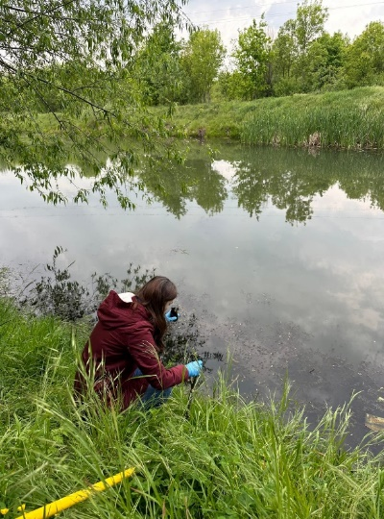
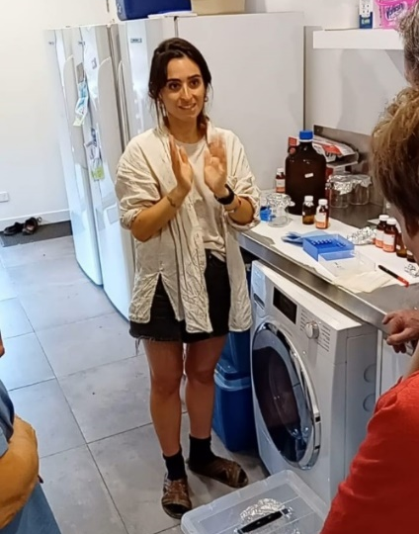
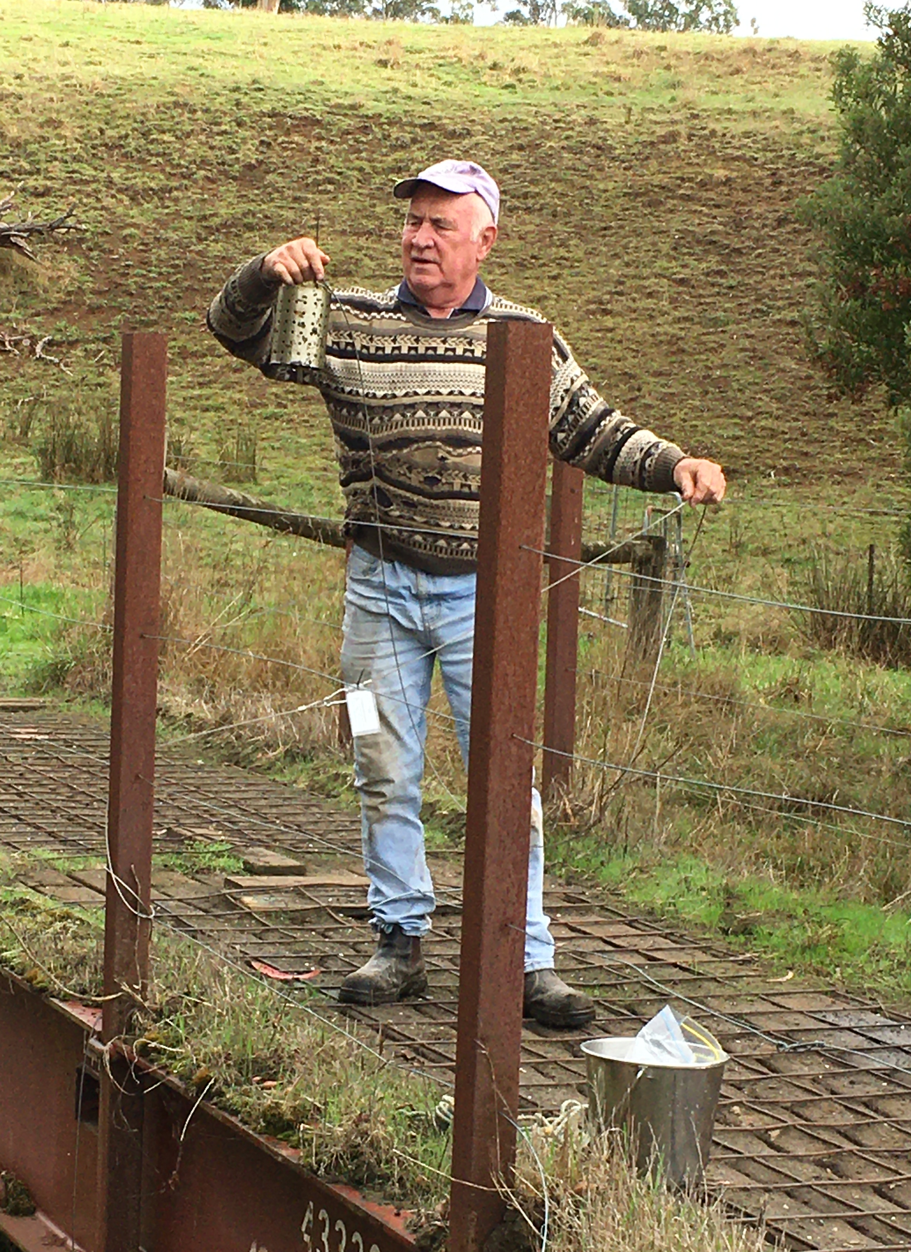
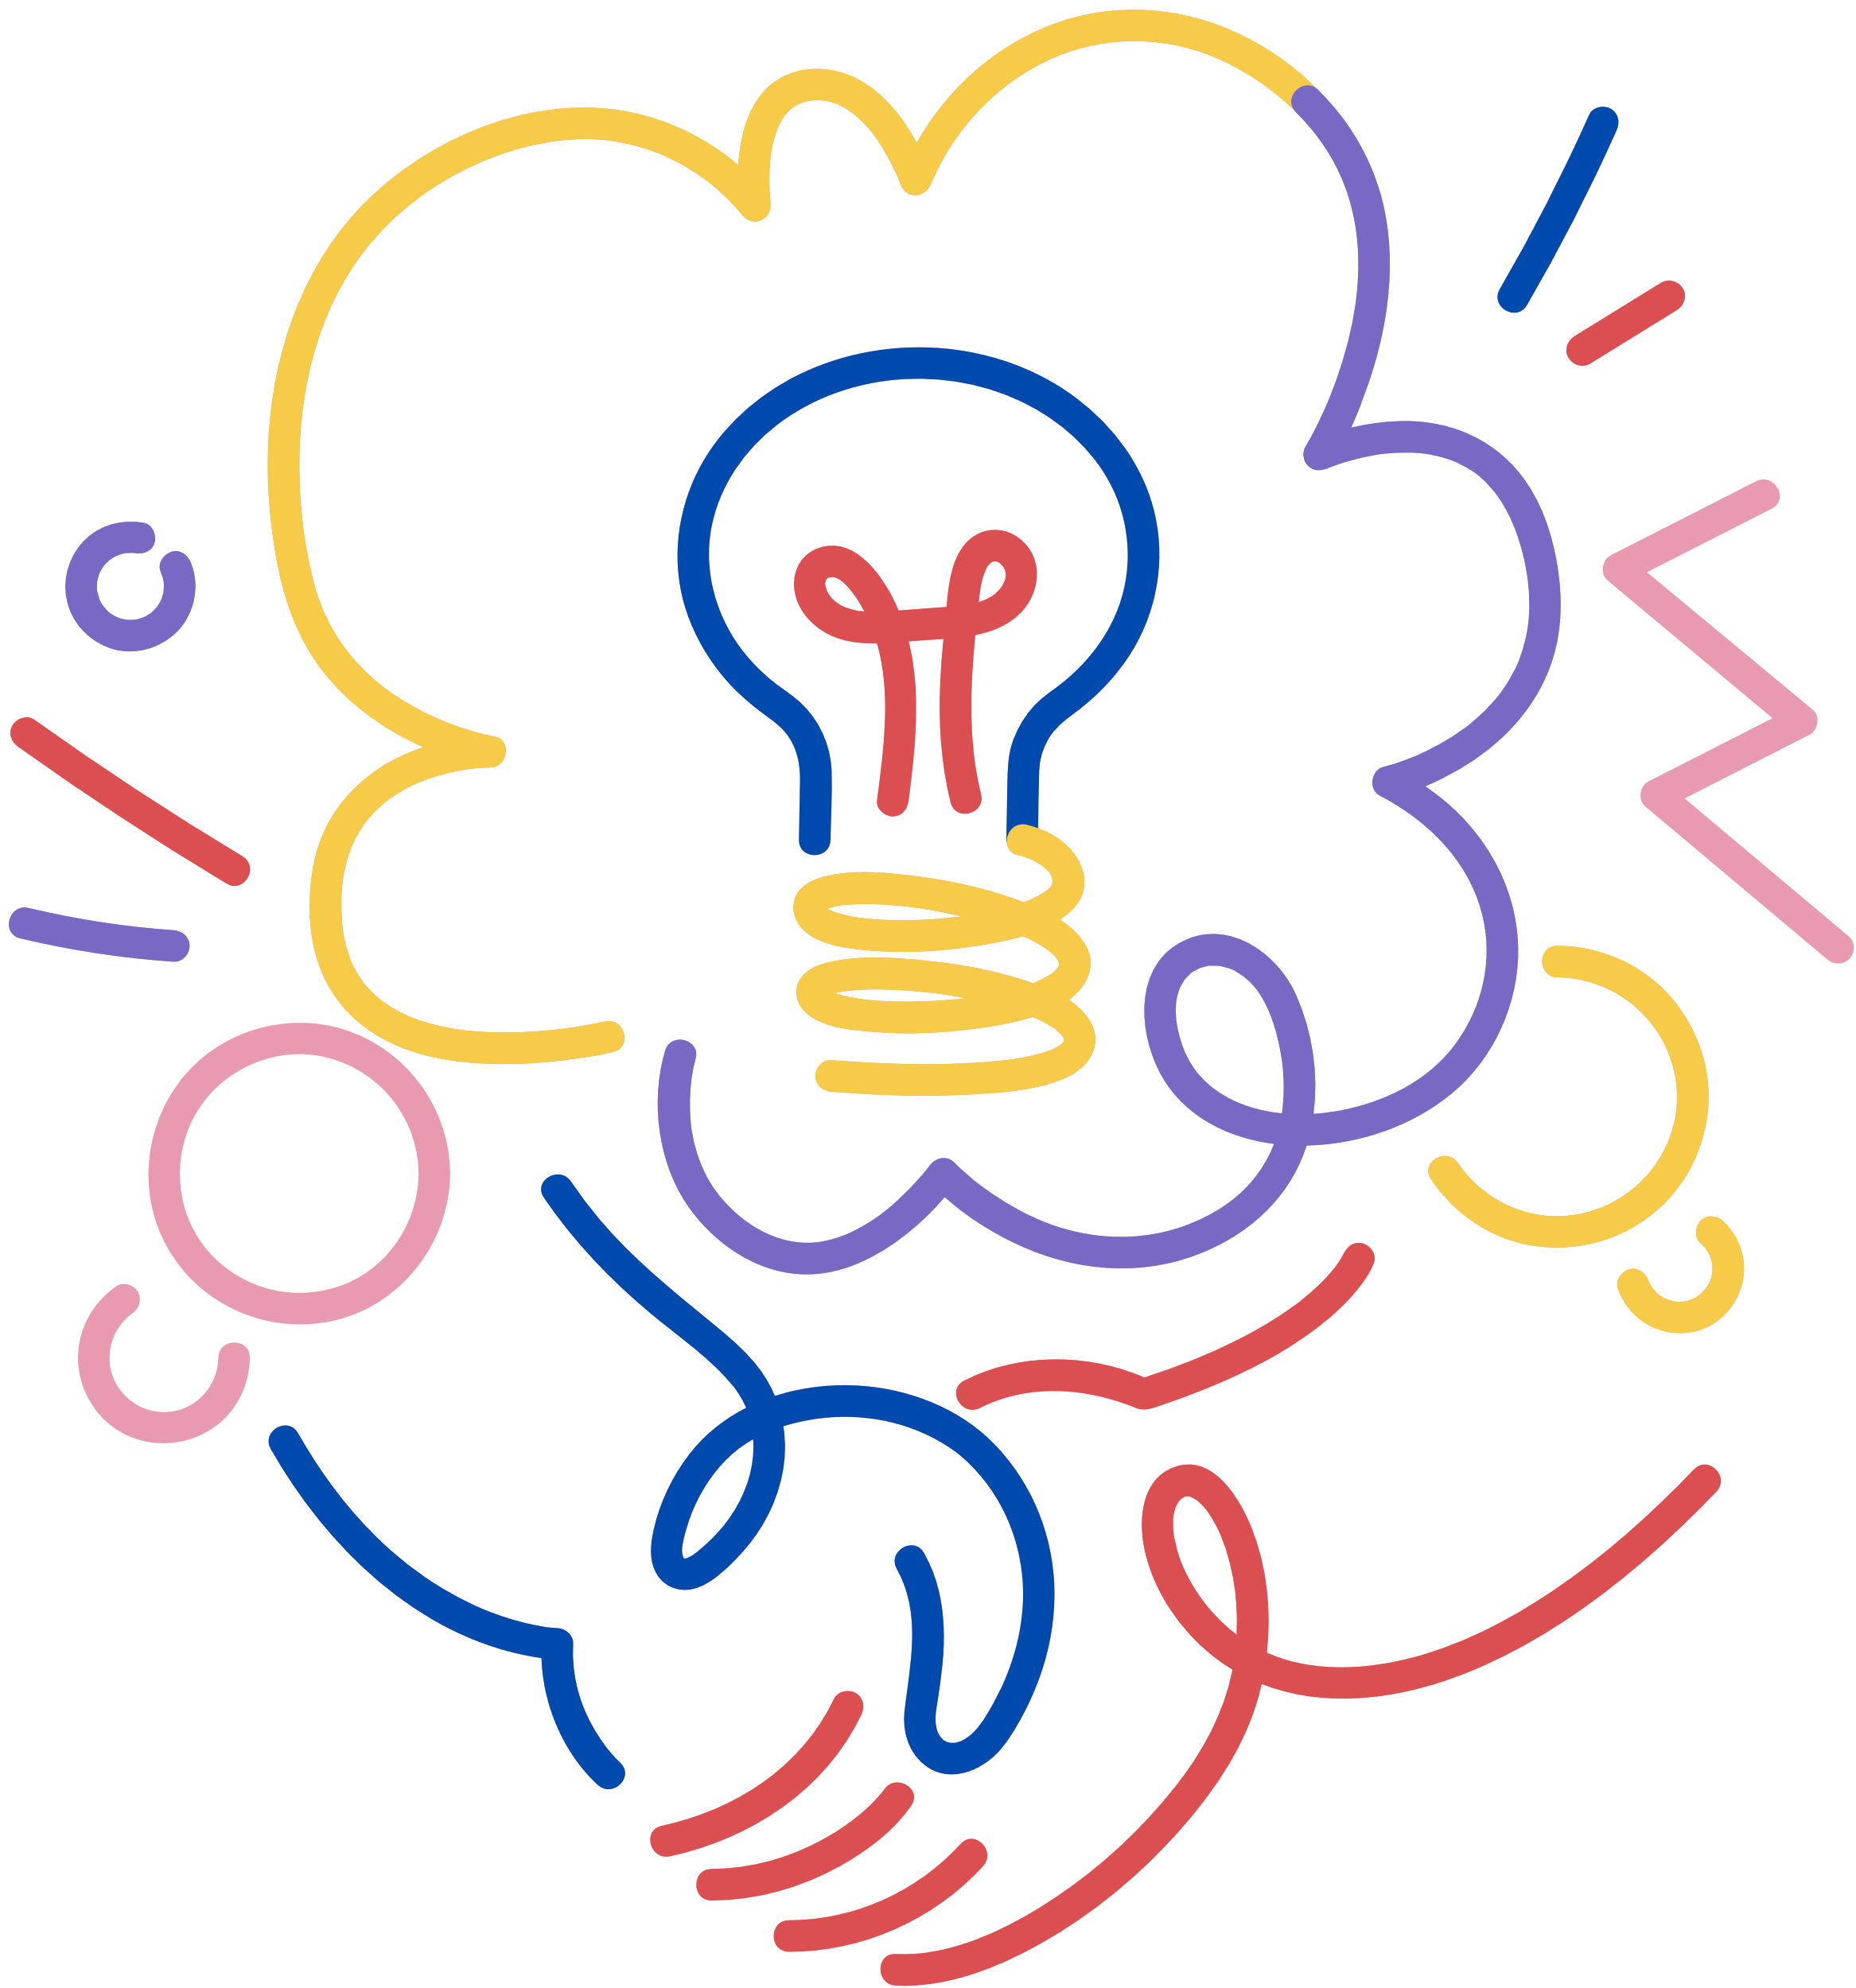

Lessons learnt
Listening & humbleness
Knowledge exchange
Social element
Importance of local observation and knowledge
"Thanks to the help of a local, we were able to extract (to collect, ed.) the sample from above a bridge with a fishing line. It was a beautiful experience [..]."
Importance of feedback loop – and of re-training
Continuous learning process to make the initiative accessible for diverse citizens group (factor: age, language,..)
Citizen science value goes beyond data collection: strengthen community and connects to land care

Slide 15
Citizen science
WHAT SCIENTISTS THINK IT IS
WHAT CITIZENSTHINK IT IS
WHAT POLICY MAKERS THINK IT IS
WHAT IT
ACTUALLY IS?

Slide 16
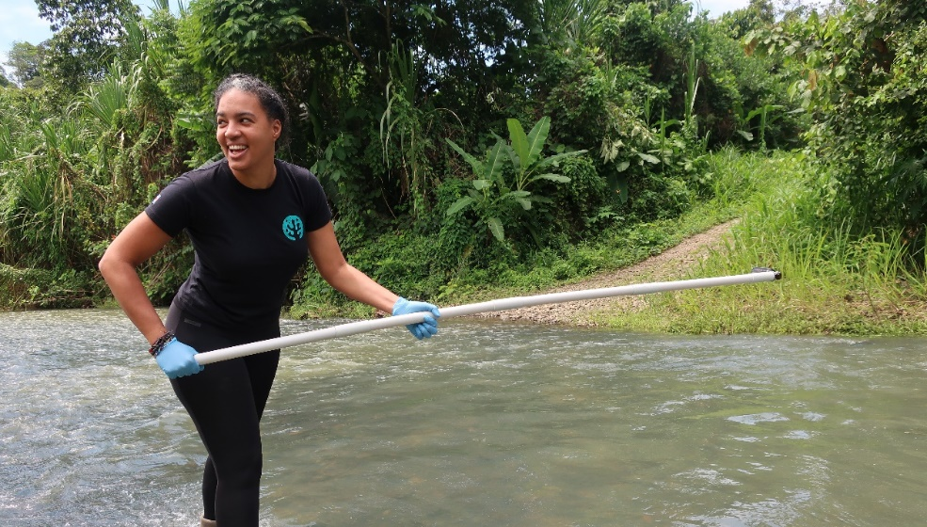
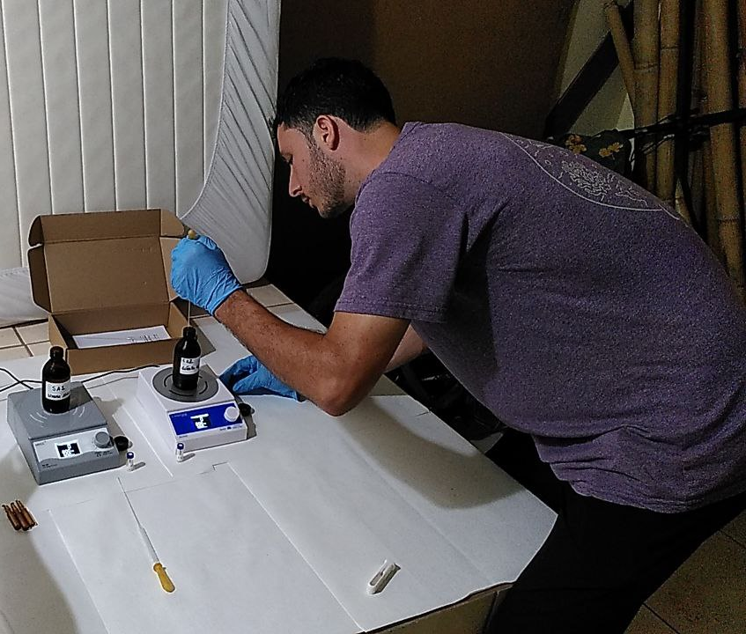
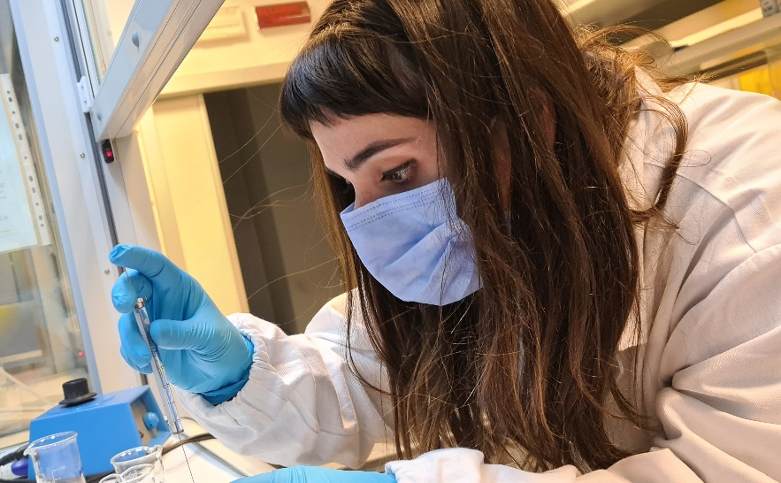
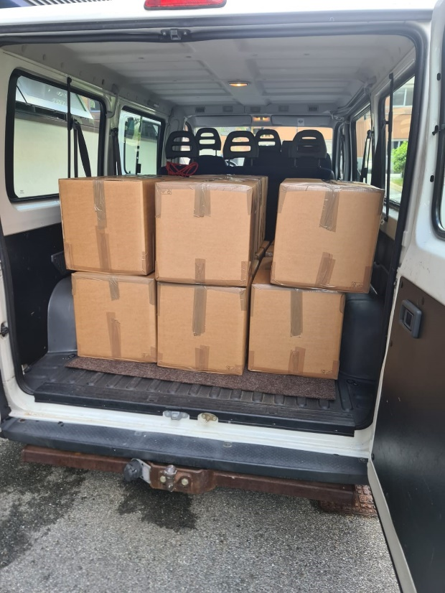
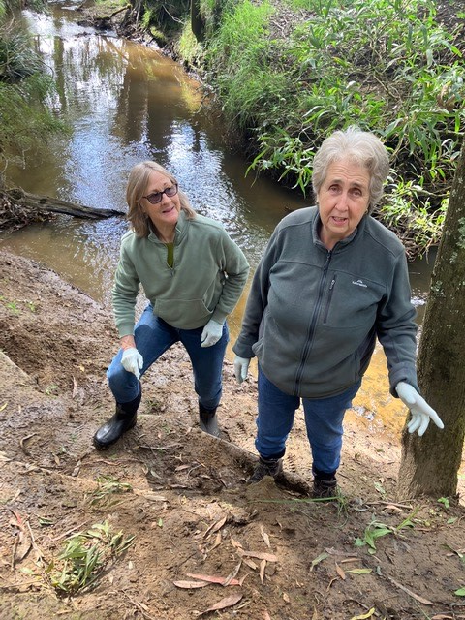
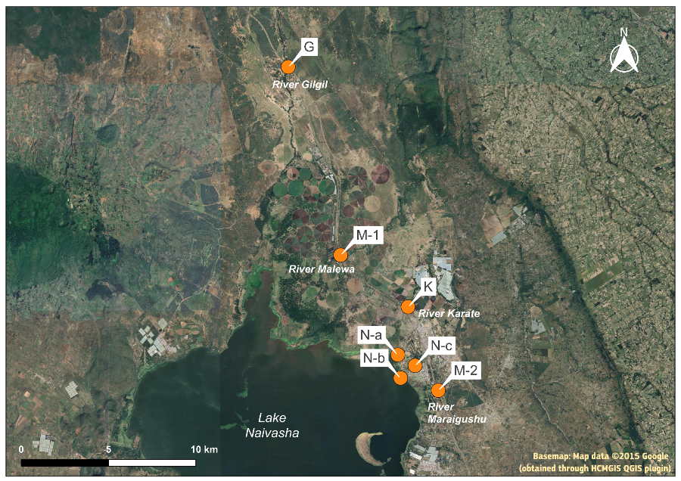
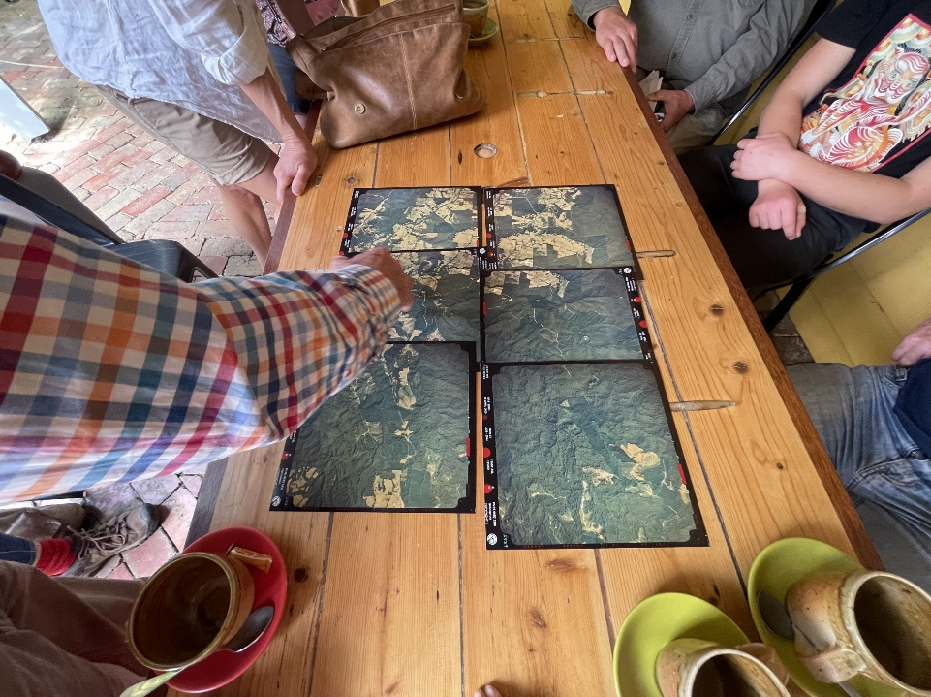
WHAT IT
ACTUALLY IS?
Notes:
An honest broker is a neutral party who facilitates discussions or negotiations without pushing their own agenda or interests. Their role is to provide objective information, clarify options, and help others—such as policymakers or conflicting parties—make informed decisions.
Why it's important:
Builds trust: Stakeholders are more likely to engage if they believe the broker is impartial.
Reduces bias: Honest brokers avoid distorting information, helping ensure decisions are based on facts.
Supports sound decision-making: By laying out all options clearly and fairly, they help others choose the best course of action.
This role is especially crucial in science, policy, and conflict resolution, where credible, unbiased guidance can significantly impact outcomes.

Slide 17


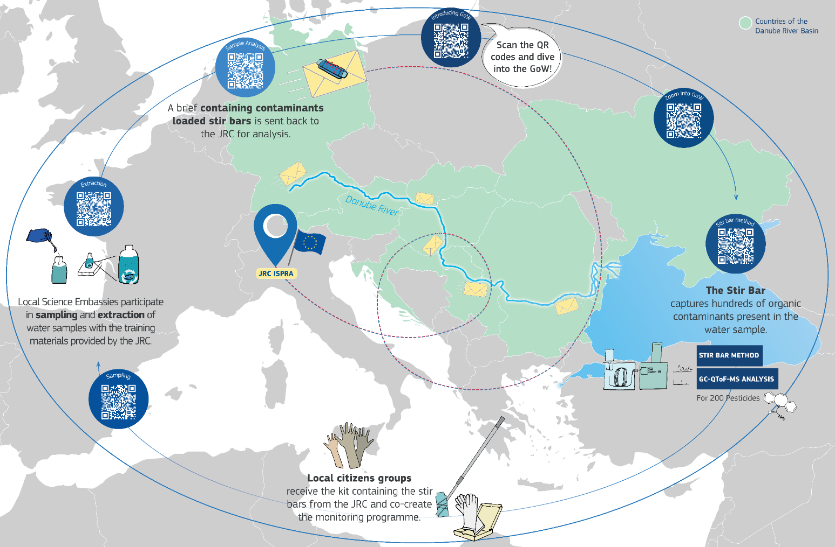
The Gems of Water x JDS5
During the 5th Joint Danube Survey (JDS5):
Students from schools in 10 countries along the Danube collected samples at 3 locations on 27-29 May,
contributing to data collection on pesticide presence in the catchment,
learning about water quality,
bringing JDS scientists closer to citizen science!

Slide 18
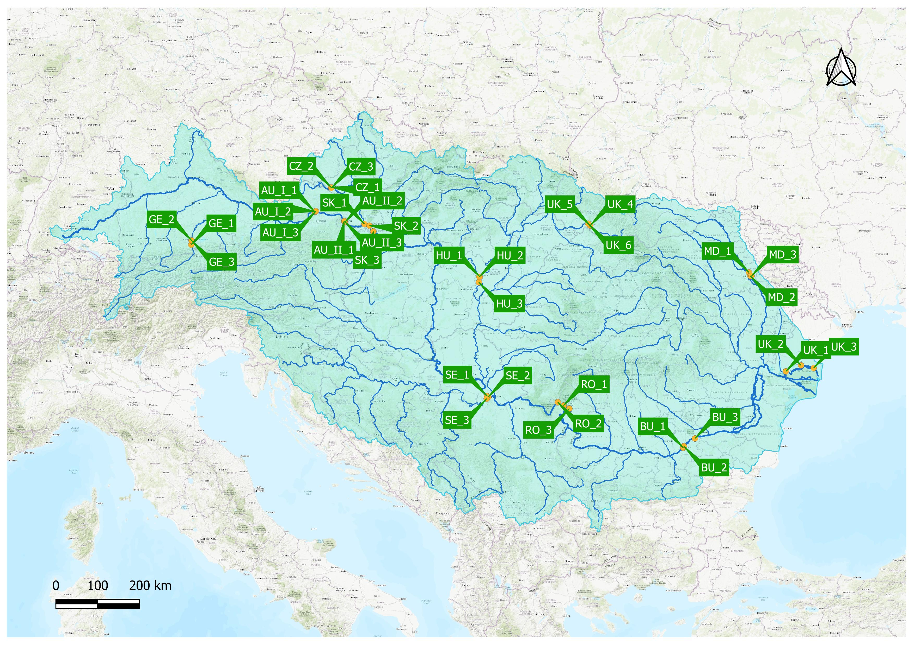
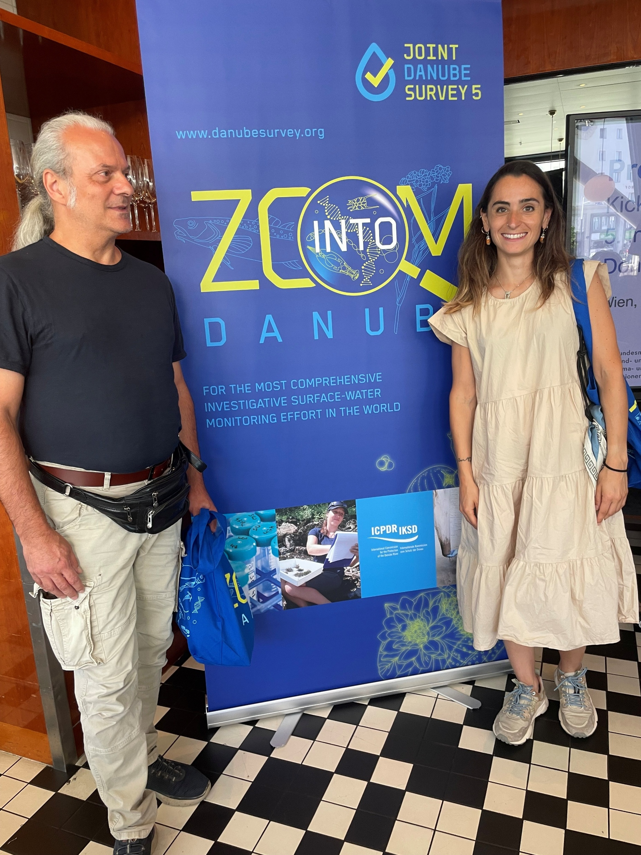
Our current project
10
countries
13
schools
39
sampling locations
90
samples

Slide 19
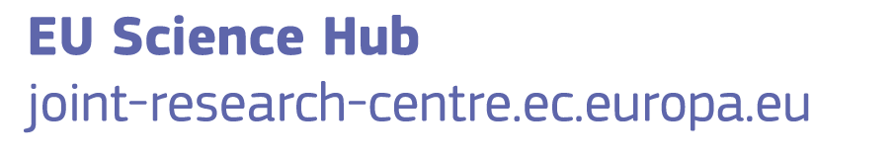
Thank you
This presentation has been prepared for internal purposes. The information and views expressed in it do not necessarily reflect an official position
of the European Commission or of the European Union.
Except otherwise noted, © European Union 2025. All Rights Reserved
Slide 3,14: images, sources: Freepik; Slide 4, 5, 11: drawing, source: https://fritsahlefeldt.com/; Slide 5: stir bar video, source: Gerstel (Germany); All other images are by the JRC Water Laboratory

